Slide 1
IR Sensor
Electronic Circuits CCE306
A Project By:
Nourhan Farag Mohamed : 231903707
Malak Mounir Abdellatif : 231903643
Razan Ahmed Fawzy : 221903165
Supervised by:
Dr. Maher Abdel Rasoul
Notes:
When listing all project collaborators, either use commas or bullets

Slide 2
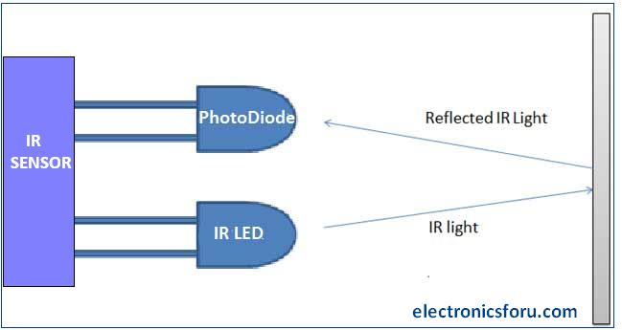
Circuit Idea
An infrared sensor is an electronic device, that emits to sense some aspects of the surroundings. An IR sensor can measure the heat of an object as well as detects the motion. These types of radiations are invisible to our eyes, which can be detected by an IR sensor.
The emitter is an IR LED, and the detector is an IR photodiode that is sensitive to IR light of the same wavelength as that emitted by the IR LED. When IR light falls on the photodiode, the resistances and the output voltages will change in proportion to the magnitude of the IR light received.
IR led is one kind of transmitter that emits IR radiations. This LED looks like a standard LED and the radiation which is generated by this is not visible to the human eye.
Once the infrared transmitter generates emission, then it arrives at the object & some of the emission will reflect toward the infrared receiver.
Types of Infrared Sensor
Active IR Sensor
This active infrared sensor includes both the transmitter as well as the receiver. In most of the applications, the light-emitting diode is used as a source. LED is used as a non-imaging infrared sensor whereas the laser diode is used as an imaging infrared sensor.
Passive IR Sensor
The passive infrared sensor includes detectors only, but they don’t include a transmitter. These sensors use an object like a transmitter or IR source. This object emits energy and detects through infrared receivers. After that, a signal processor is used to understand the signal to obtain the required information.

Slide 3
Working Principle
In this project, the transmitter section includes an IR sensor, which transmits continuous IR rays to be received by an IR receiver module. An IR output terminal of the receiver varies depending upon its receiving of IR rays. Therefore, this output can be fed to a comparator circuit. Here an operational amplifier (op-amp) of LM 358 is used as a comparator circuit.
When the IR receiver does not receive a signal, the potential at the inverting input goes higher than that non-inverting input of the comparator IC (LM358). Thus, the output of the comparator goes low, but the LED does not glow. When the IR receiver module receives a signal to the potential at the inverting input goes low. Thus, the output of the comparator (LM 358) goes high and the LED starts glowing.
Resistor R1 (330 ), R2 (10k ), and R3 (330) are used to ensure that a minimum of 10 mA current passes through the IR LED Devices like Photodiode and normal LEDs, respectively. Resistor VR1 (preset=10k ) is used to set the sensitivity of the circuit Diagram.

Slide 4
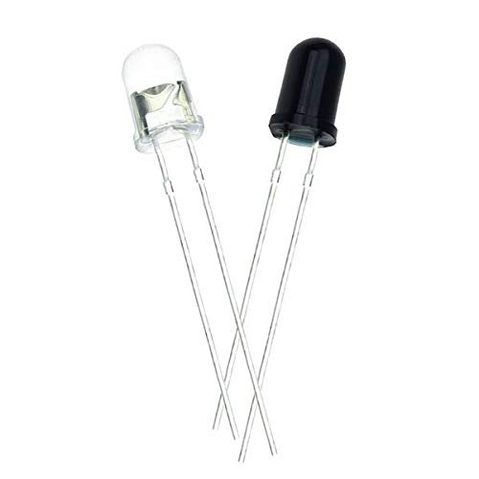
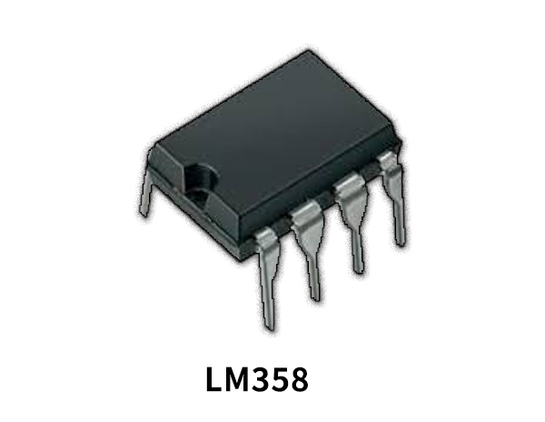
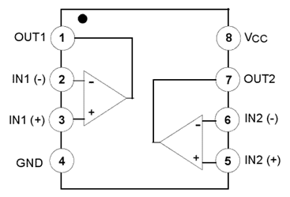
The Used Components
LM358 (the main component)
IR pair (IR LED and Photodiode)
Pin Description:
Pin 1 and 7 are outputs of comparator
Pin 2 and 6 are inverting inputs
Pin 3 and 5 are non-inverting inputs
Pin 4 is ground (GND)
Pin 8 is VCC+
IR LED(transmitter) is a special purpose LED that transmits infrared rays in the range of 760nm wavelength
Photodiode is a detector capable of converting light into either current or voltage, depending upon the mode of operation.
Notes:
Think about the questions listed above and answer them.
Can you think of anything else in regards to economy and trade that you would like to add?

Slide 5
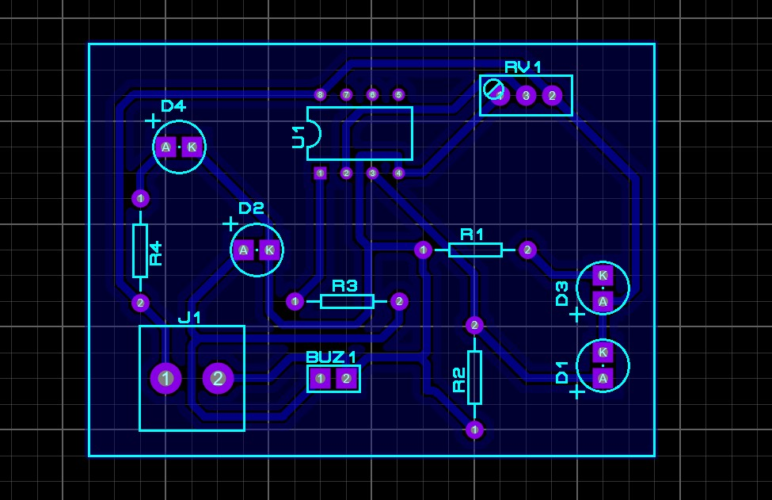
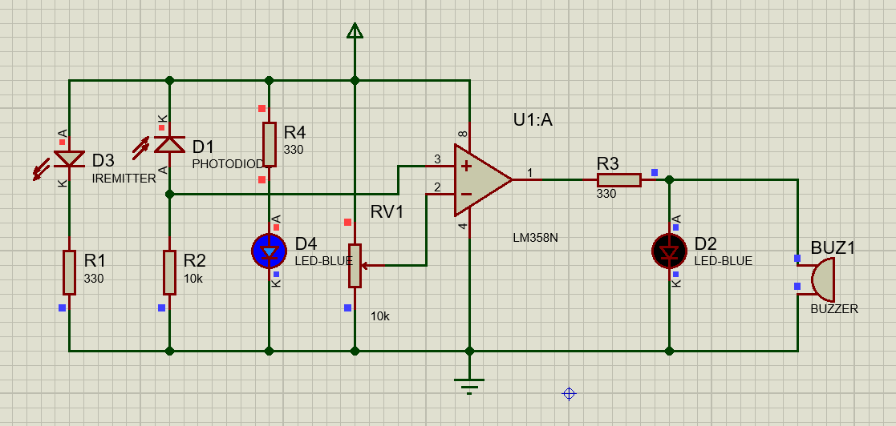
Circuit Diagram
PCB Layout
Schematic on Proteus

Slide 6
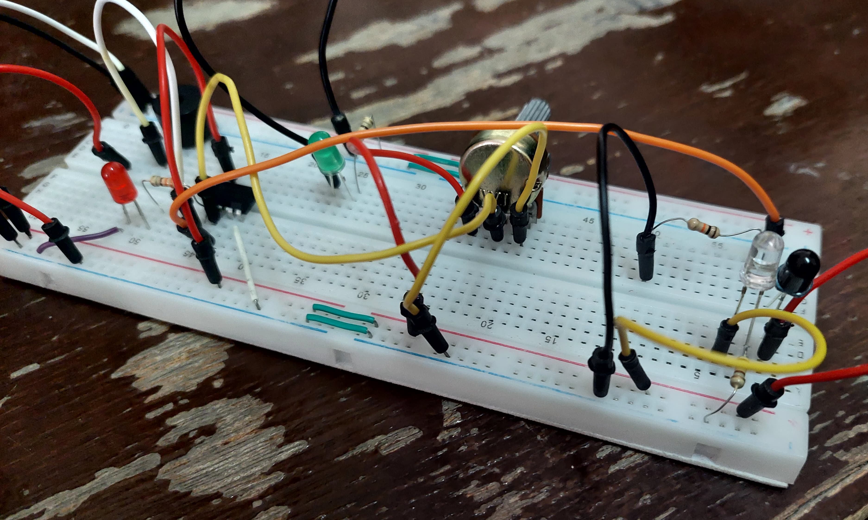
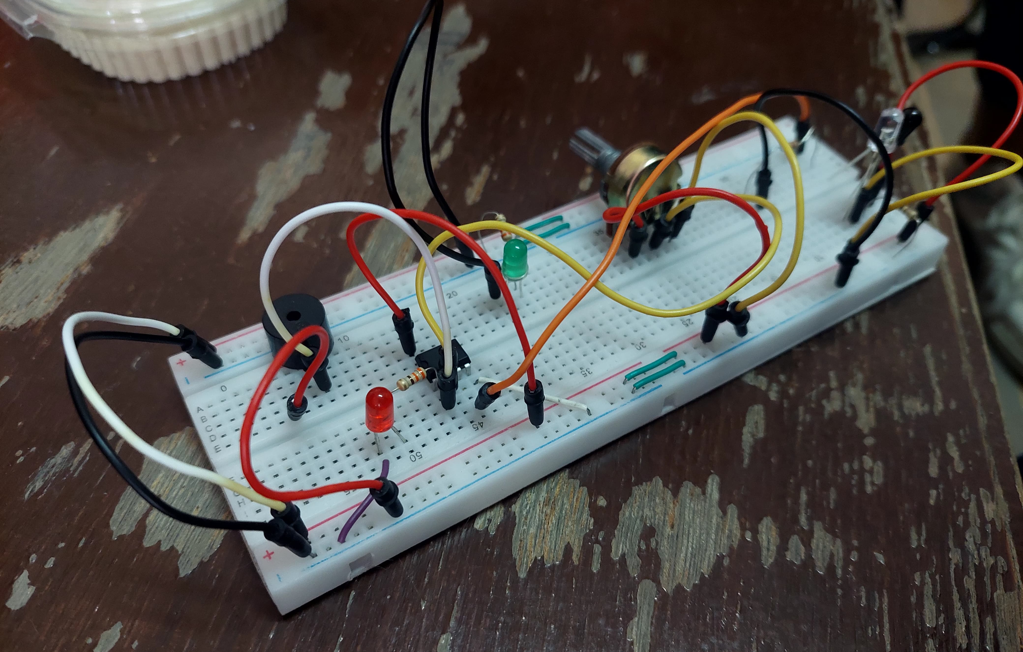
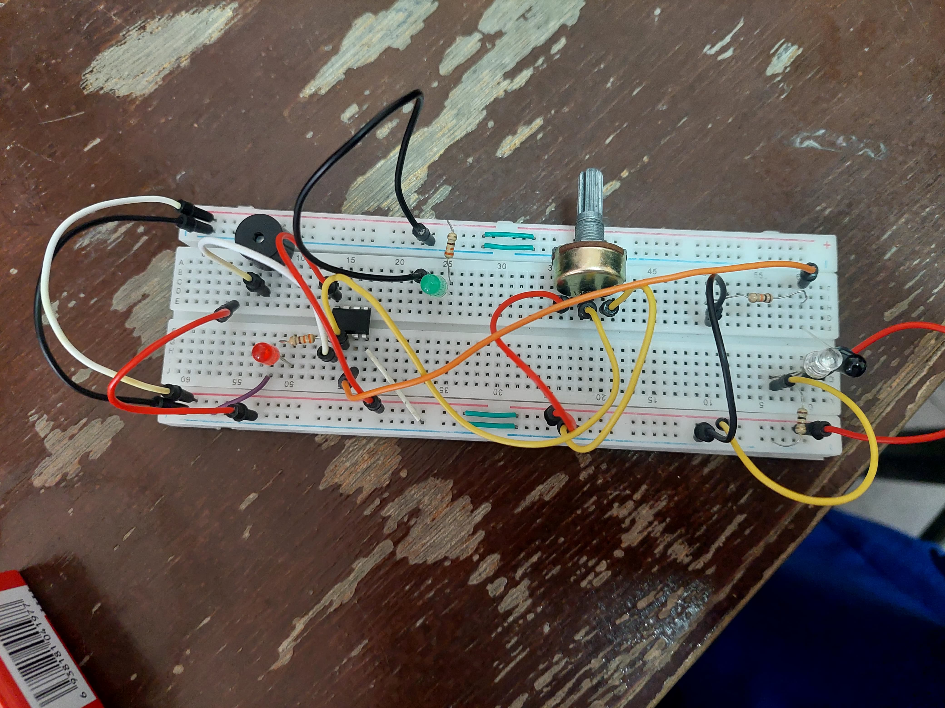
Circuit on Breadboard

Slide 7
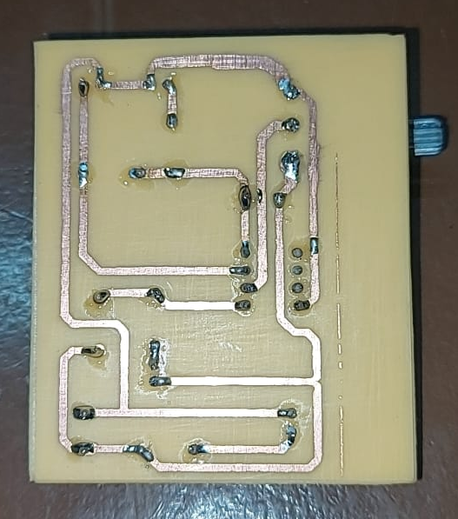
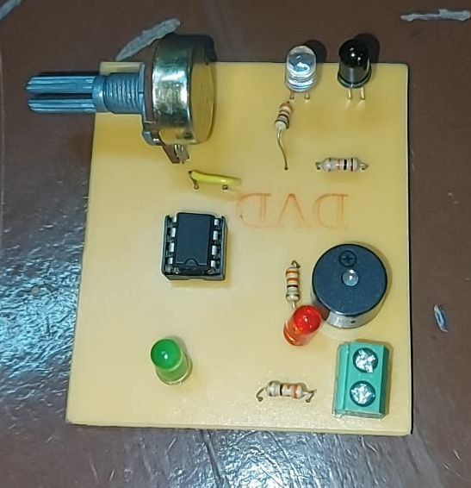
Circuit in Real
Notes:
Insert a map of your colony (draw it, ink it, or create it in PPT- be creative!)
Insert -> Pictures for photos
Draw for digital inking
Insert -> Shapes if you want to create it in PPT
All mountains, towns/villages, bodies of water/waterways, landmarks, etc. should be clearly labeled

